Slide 1
INFRUSTRACTURE - considerations
What tools
Where is data from
Banking Sentiment Analysis
{insert problem statement}

Slide 2
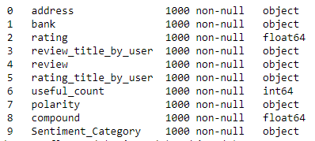
About the Data:
Author – The user who authored the review, providing valuable insights into the reviewer’s identity and perspective.
Date – The date when the review was submitted, offering a temporal dimension to the dataset and enabling time-based analysis.
Address – The geographical location from which the review was written, contributing to understanding regional trends and variations in banking experiences.
Bank – The name of the reviewed bank, serving as a key identifier for the financial institution being assessed.
Rating – The user’s numerical assessment of the bank’s service, indicating user satisfaction on a numerical scale.
Review_titile_by_user – The user-assigned title to their review, summarizing the essence of their feedback in a concise manner.
Review – The detailed content of the user’s review about the bank, providing the primary textual data for analysis and insights.
Bank_image – The URL pointing to the bank’s logo or image relevant to the review, facilitating visual associations with the bank.
Rating_title_by_user – The user-assigned title to their rating, potentially offering additional context to the rating value.
Useful_count – The count of users who found the review helpful, reflecting the impact and usefulness of the review among other users.

Slide 3

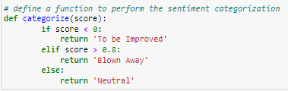

EDA

Slide 4
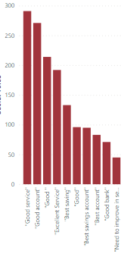
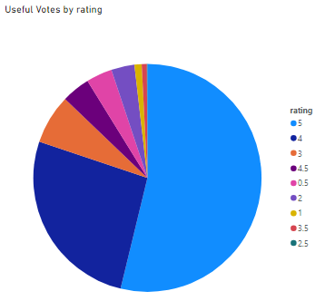

Slide 5
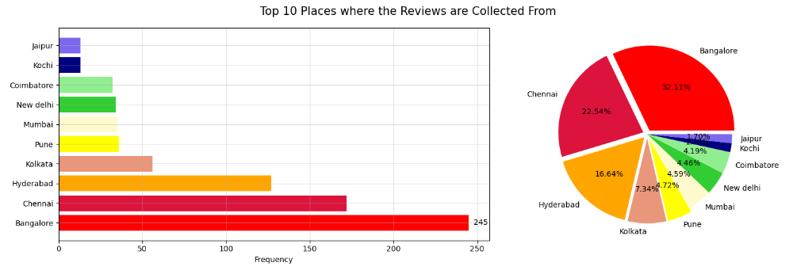
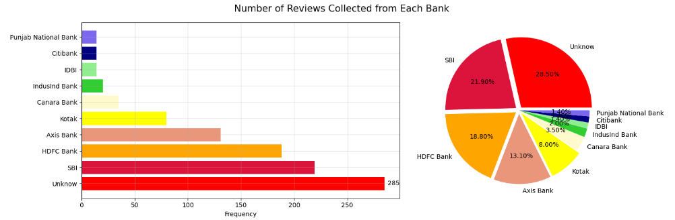

Slide 6
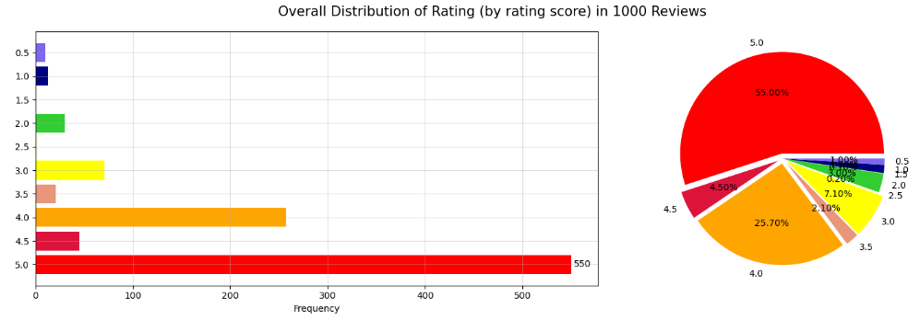
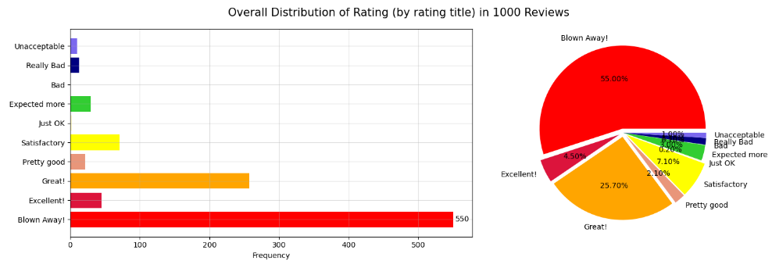

Slide 7
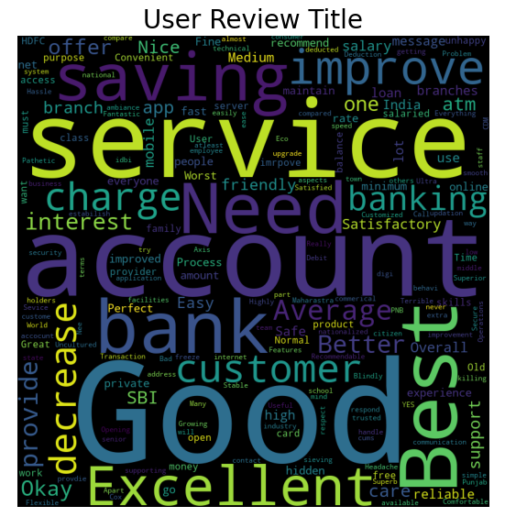
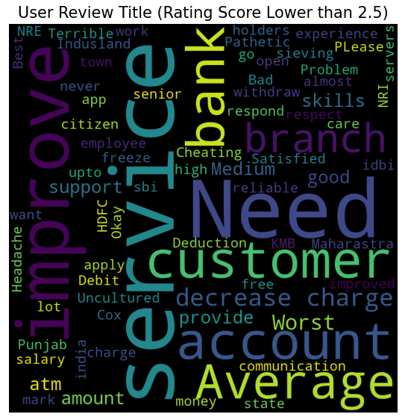

Slide 8
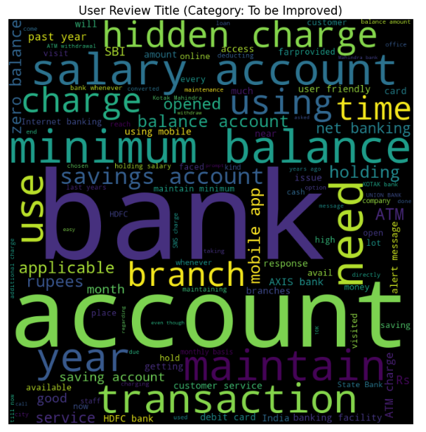
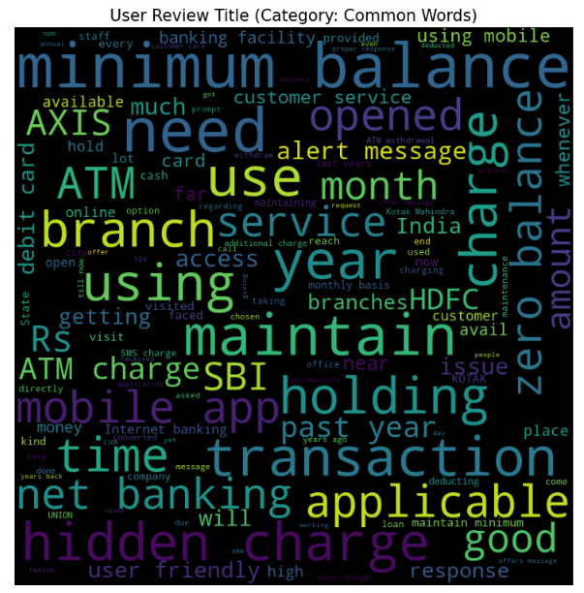

Slide 9
{insert recommendations}

